Slide 1


Project Presentation

Slide 2

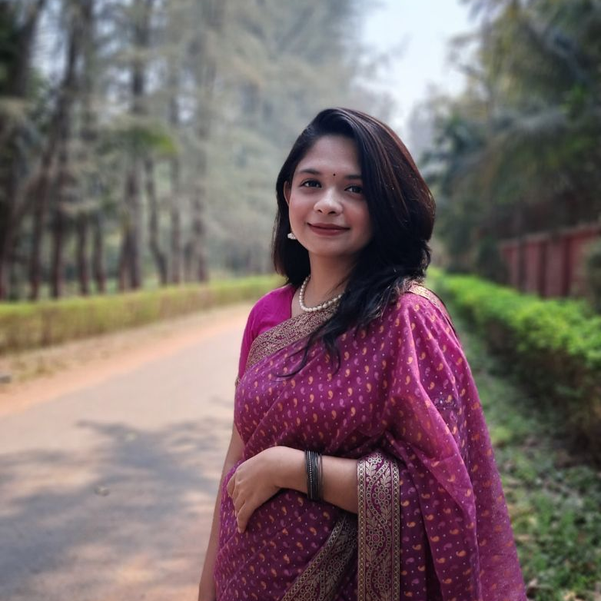
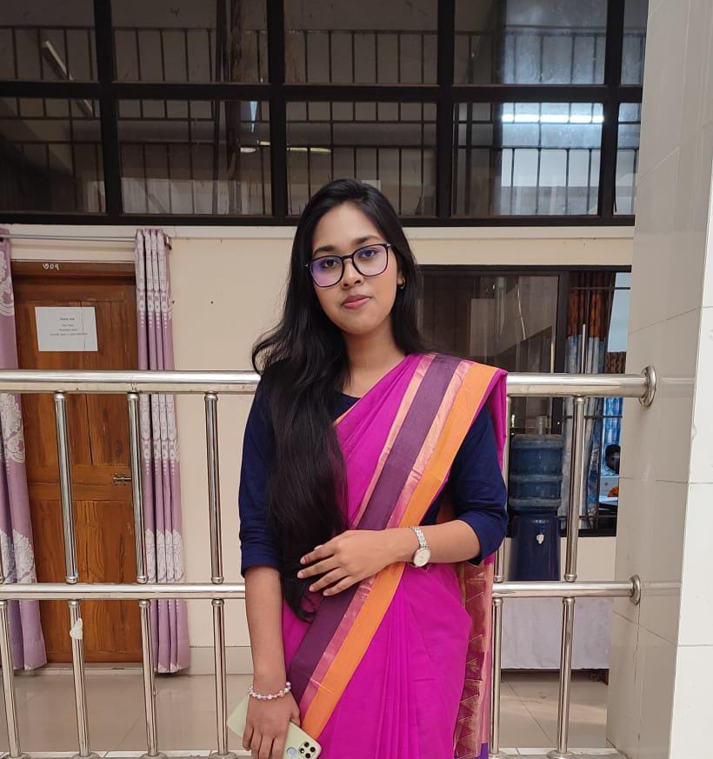

MEET THE TEAM
Rajib Kumar Dhar
Nafisa Binte Jashim
ID: MUH2125005M
Session: 2020-21
Year: 03 Term: 01
✉️ e-mail: rajib2516@student.nstu.edu.bd
ID: BKH2125014F
Session: 2020-21
Year: 03 Term: 01
✉️ e-mail: nafisa2516@student.nstu.edu.bd
Nadia Jahan
Sidratul Muntaha
ID: BFH2125017F
Session: 2020-21
Year: 03 Term: 01
✉️ e-mail: nadia2516@student.nstu.edu.bd
ID: BKH2125026F
Session: 2020-21
Year: 03 Term: 01
✉️ e-mail: nisha2516@student.nstu.edu.bd

Slide 3

Project Introduction:
Welcome to ZenithZone, where shopping transcends the ordinary. Experience the perfect blend of convenience and personalization with features like Voice Search, tailored recommendations, and seamless Wish List management. Discover unique artisan creations, explore a thriving second-hand marketplace, and turn every purchase into a journey of joy and satisfaction. ZenithZone—your destination for inspired shopping.

Slide 4

Functional Requirements

Slide 5
Functional Requirements
Log in
Add to cart
Wish list
Sign up

Slide 6
Functional Requirements
Auto Search
Voice Search
View Cart
Coupon

Slide 7
Functional Requirements
Personalized Product Recommendations
Art and Craft Exhibition
Second Hand Product

Slide 8
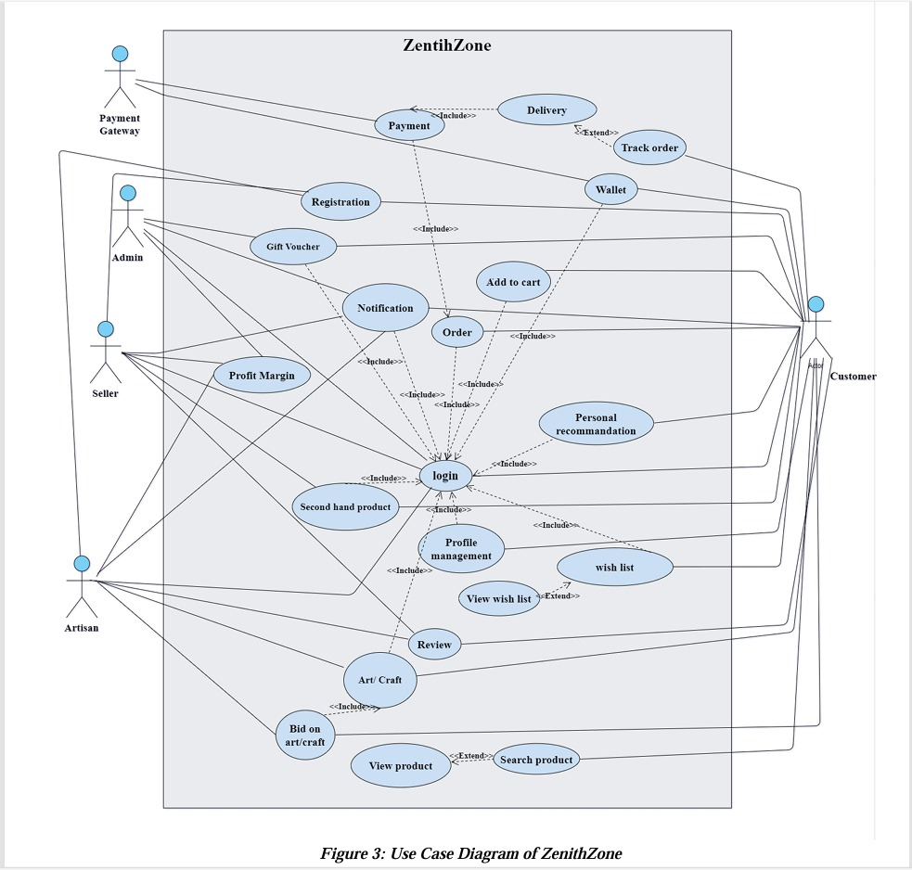
Use Case of ZenithZone

Slide 9
Use Case Description (Actors)
Customer
Admin
Seller
Artisan
Payment Gateway

Slide 10
Use Case Description
Sign up
Log in
Second Hand Products
Coupon

Slide 11
Use Case Description
Art & Craft
Personal Recommendation
Add to Cart
Wish List

Slide 12
Use Case Description
Auto Search
Voice Search
Wallet
View Cart

Slide 13



Languages and Tools
Frontend Development:
HTML
CSS
JavaScript
Backend Development:
PHP
Database Management:
SQL (Structured Query Language)
VS Code

Slide 14
ZenithZone Database (Tables)
artist_wallet
art_bids
art_gallery
autocom
carts
cart_items
coupon
customer_info
artist_info

Slide 15
ZenithZone Database (Tables)
customer_wallet
orders
order_items
product_info
second_hand_product
sellersinfo
seller_wallet
wishlist
wishlist_items

Slide 16
ZenithZone Database (Tables - > Primary Key)
artist_info : artist_id
artist_wallet : wallet_id
art_gallery: art_id
art_bids : bid_id
carts: cart_id
cart_items: cart_item_id
coupon: coupon_id
customer_info: customer_id
customer_wallet: wallet_id
orders : order_id
order_items : order_item_id
product_info : Product_code
second_hand_product : Sh_product_id
sellersinfo: seller_id
seller_wallet : wallet_id
wishlist : wishlist_id
wishlist_items: wishlist_item_id

Slide 17
ZenithZone Database (Relationships)
artist_wallet.artist_id → artist_info.artist_id
art_gallery.artist_id → artist_info.artist_id
cart_items.cart_id → carts.cart_id
cart_items.product_id → product_info.Product_id
wishlist_items.product_id → product_info.Product_id
customer_wallet.customer_id → customer_info.customer_id
seller_wallet.seller_id → sellersinfo.seller_id
second_hand_product.seller_id → sellersinfo.seller_id
order_items.product_id → product_info.Product_id
order_items.order_id → orders.order_id
wishlist_items.wishlist_id → wishlist.wishlist_id
customer_wallet.customer_id → customer_info.customer_id
second_hand_product.seller_id → sellerinfo.seller_id

Slide 18

Summery
ZenithZone is an e-commerce platform connecting Customers, Sellers, Artisans, and Admins for seamless transactions and personalized experiences. It supports core features like sign up, login, payments via a Payment Gateway. Advanced options such as personalized recommendations, second-hand products, and bidding for unique art enhance user engagement.

Slide 19


